Slide 1
ANN continued…

Slide 2
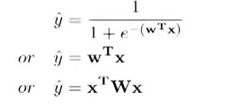
Components of a typical ML setup
Data: {x_{i}, y_{i}} ^{n} _{i=1}
Model: Our approximation of the relation between x and y. For example,
or just about any function
Parameters: In all the above cases, w is a parameter which needs to be learned from the data.
Learning algorithm: An algorithm for learning the parameters (w) of the model (eg: PLA, Gradient descent, etc.)
Objective/Loss/Error function: to guide the learning algorithm.

Slide 3
Training error and testing error
Now, any kind of learning what is it driven by? It is driven by errors , objective function. And so, the analogy which I like to give is, suppose you are trying to learn trigonometry, right you have a chapter that is your training data, the chapter has a lot of formulae, that is your training data.
Now what is your objective? There are 2 objectives.
The Training time objective is that once you read to the chapter a few times, at least whatever formulae are given in the chapter, you should be able to produce the correct output for that.
So, if I ask you what is sin²a + cos²a, you should be able to answers them. And you should be able to give me the correct answer.
So, in other words you are trying to minimize the error on the training data. Whatever training data you have which is the chapter content, you want to make 0 errors in anything which is given in the chapter. That is your Training error.

Slide 4
There is also something as known as a Test error. Because after you have learnt the chapter. I will give you an independent set of exercises, which might contain questions which are not seen in the textbook earlier.
Now I could ask you some other formula, which you should be able to give me answers, if you have learnt the chapter properly. So now, right now we are just talking about the training error; that means, getting all the formula in the chapter correctly, and our chapter is actually the training data which is given to you, this is what we are reading.
So, this always going to be driven by an objective function, and our goal is just as we wanted to minimize the errors that we make on the formula given in the chapter. We want to minimize the errors on the training data;

Slide 5
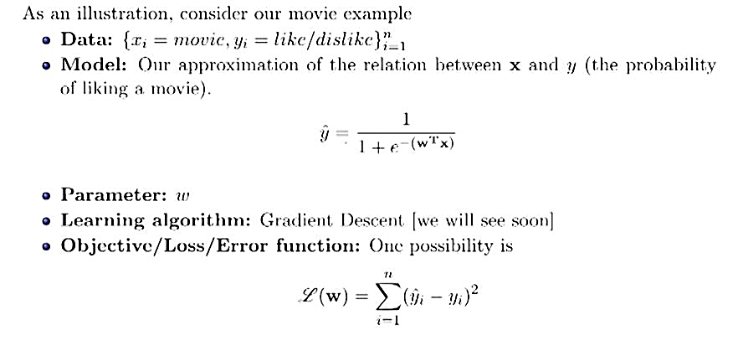
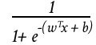
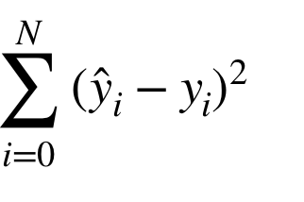
Consider our movie example
Data: {x_{i} = movie, y_{i} = like/dislike} ^{n}_{i=1}
Model: Our approximation of the relation between x and y( the probability of liking a movie)
Parameter: w
Learning algorithm: Gradient Descent
Objective/Loss/Error function: One possibility is

Slide 6
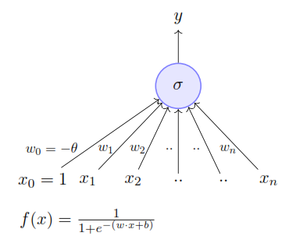
Learning parameters
Keeping this supervised learning setup in mind we will now focus on this model and discuss an algorithm for learning the parameters of this model from some given data using an objective function.
σ stands for sigmoid function.

Slide 7
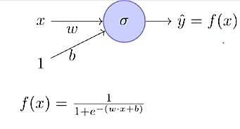
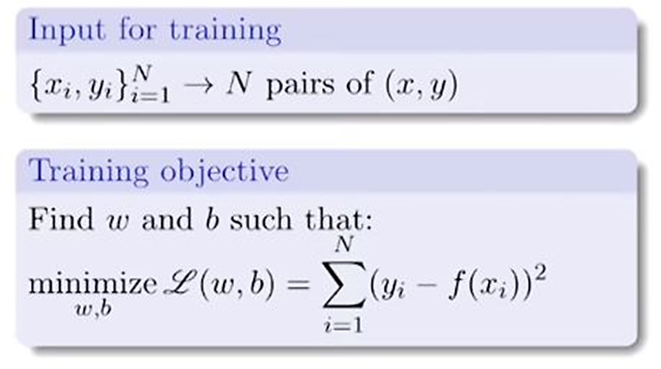
For ease of explanation, we will consider a very simplified version of the model having just 1 input.
From now onwards we will refer w₀ as b (bias).
Lastly, instead of considering the problem of predicting like/dislike, we will assume that we want to predict criticsRating (y) given imdbRating (x).

Slide 8
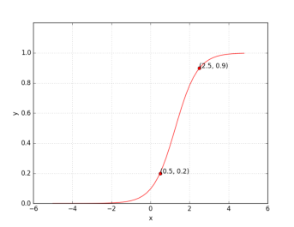
What does it mean to train the network?
Suppose we train the network with (x,y) = (0.5, 0.2) and (2.5, 0.9)
At the end of training we expect to find w* and b* such that :
f(0.5) 0.2 and f(2.5) 0.9.
In other words..
We hope to find a sigmoid function such that (0.5,0.2) and (2.5,0.9) lie on this sigmoid curve.

Slide 9
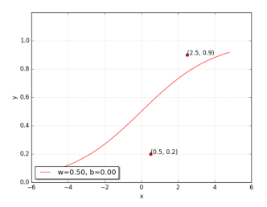
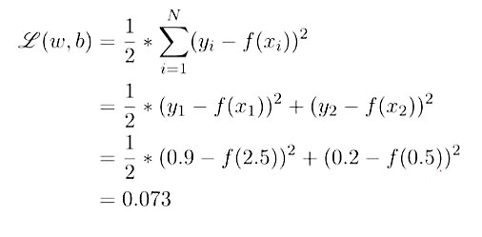
Can we try to find such w* and b* manually?
Let’s try a random guess (say w = 0.5, b=0)
Clearly this generated curve is not good. But how bad it is?
Let’s see L(w, b) to see how bad it is
We want L(w,b) to be as close to 0 as possible.

Slide 10
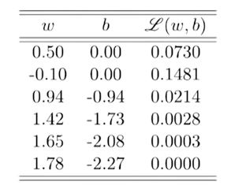
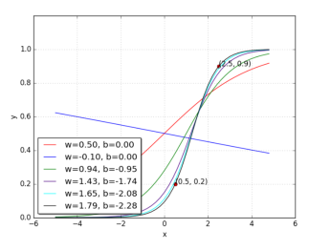
Let’s try some different values for w and b
With some guess work and intuition we were able to find the right values for w and b.

Slide 11
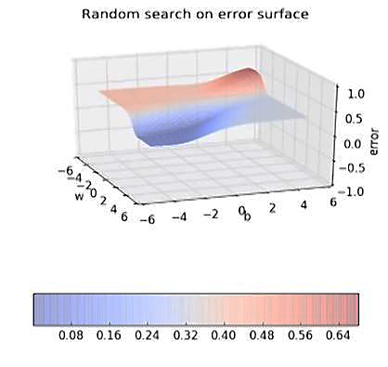
Since we have only 2 points and 2 parameters (w,b) we can easily plot L(w,b) for different values of w and b and pick the one where L(w,b) is minimum.
But when we have more data points and more parameters, this approach becomes infeasible.
Further, even here we have plotted the error surface only for small range of (w,b) i.e. from (-6,6) and not from (-infinity to +infinity)

Slide 12
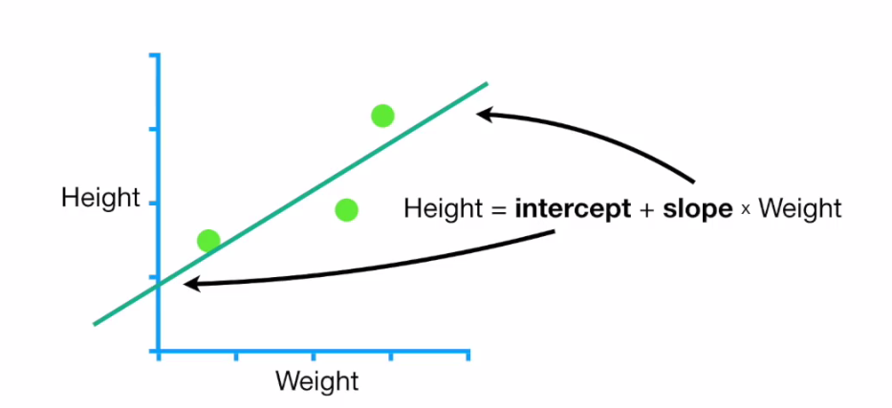
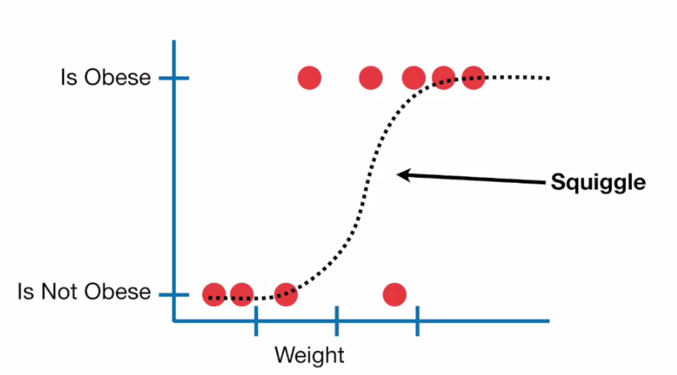
Gradient descent (for learning parameters)
In ML we optimize a lot of stuff. Such as in Linear regression, we optimize slope and intercept, in logistic regression we optimize the sigmoid curve, etc.
The cool thing about gradient descent is that it can optimize all of the algorithms. So, if we learn the strategy for applying gradient descent to one algorithm, we will automatically learn it for all other algorithms.

Slide 13
Gradient Descent analogy
Imagine you're hiking through a mountain range, and as night approaches you want to find a nice lower-elevation spot to set up camp for the night. Your goal is to find the lowest elevation in your immediate vicinity.
However, the fog is a bit thick, so you can't actually see the lowest spot. You can only see a few feet in each direction. How can you try to find the lowest spot?
One strategy to do this would be to always walk in the direction that points the most downhill, and keep walking until it's impossible to walk downhill any further.
It's not a bad strategy - it should work pretty well most of the time. The main downside to this strategy is that you might end up in a small hole, where if you could only walk uphill just a little bit, you could reach a much lower point.
How this applies in math is when you're trying to find a local minimum of a function. Let's try this one as an example:
f(x) = x² - 6x + 9
Now, obviously there's an analytical solution to this equation - i.e. you could factor it or use the quadratic formula. But pretend for a moment that you couldn't do that - there are lots of equations for which these tricks don't work.
How could you find the minimum of this function - in other words, the value of x such that f(x) has the smallest possible value?
Gradient descent is one such way - start with any value of x, like x=0. Compute f(x). Now compute the gradient of f at that point x, which is basically the slope of the function. Now move x a little bit in the direction of the slope, which puts it a bit closer to the minimum value. When you get to x=3, the gradient is zero, meaning you've found a local minimum.
This method finds local minima - meaning that a function could have more than one "valley", and gradient descent only finds the closest one.

Slide 14
Where is this used in the real world?
You've got some function that expresses some real-world formula, often a function of many variables. It may be a function that tells you the total cost of a machine you're building, where the variables are the size of various pieces of the machine. Making one piece smaller and cheaper might result in another piece being larger and more expensive, so it's not obvious what combination of values results in the cheapest solution. Gradient descent is one way to find the set of inputs to your function that minimizes the output value.
Note that it works equally well in reverse, i.e. to maximize something. Imagine you're trying to maximize profit at a company. You come up with a formula for expected profit based on the number of products you manufacture, the advertising budget, and the number of sales employees. Gradient descent could help you figure out what permutation of those variables would maximize profit.

Slide 15
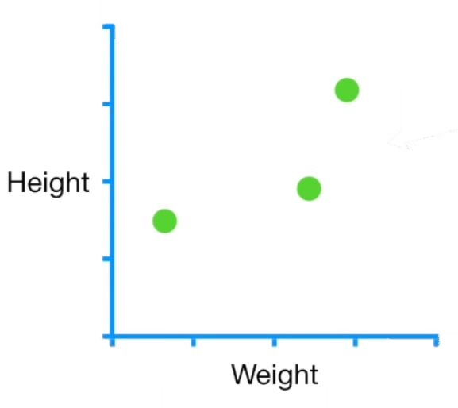
So let’s start with a simple dataset

Slide 16
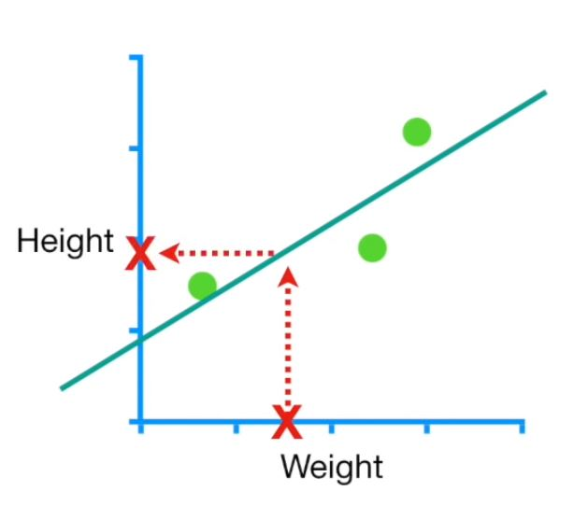
If we fit a line to the data and someone tells us that they weigh 1.5, we can use the line to predict that they are 1.9 tall
Predicted height = Intercept + Slope x Weight
So, let’s learn how Gradient descent can fit a line to the data by finding optimal values for intercept and slope.

Slide 17
Predicted height = Intercept + Slope x Weight
We’ll start by using Gradient descent to find the intercept.
Then, once we understand how Gradient descent works, we’ll use it to solve for the Intercept and Slope.
So for now, let’s plug in the least squares estimate for the slope, 0.64 and we’ll use Gradient descent to find the optimal value for the intercept.
Predicted height = Intercept + 0.64 x Weight

Slide 18
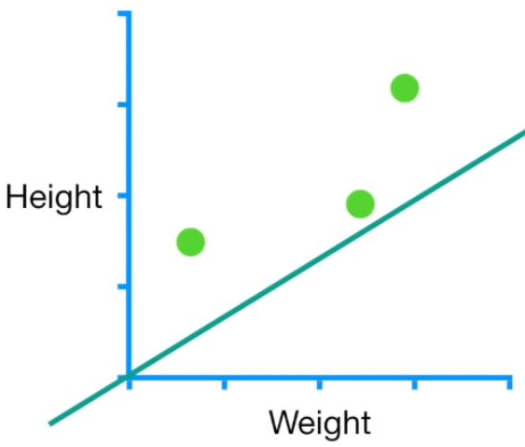
The first thing we do is pick a random value for intercept.
This is just an initial guess that gives Gradient descent something to improve upon.
In this case we’ll use 0, but any number will do fine.
Predicted height = 0 + 0.64 x Weight

Slide 19
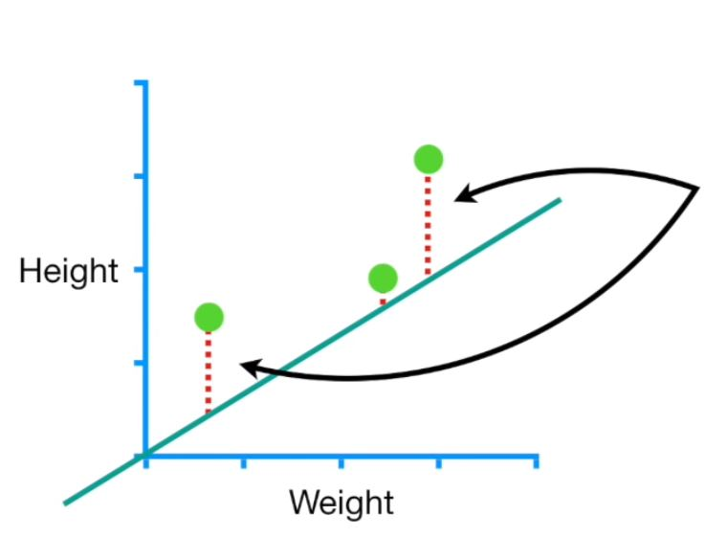
In this example, we will evaluate how well this line fits the data with the
Sum of Squared Residuals.
NOTE: In ML Sum of Squared Residuals is a type of Loss Function.

Slide 20
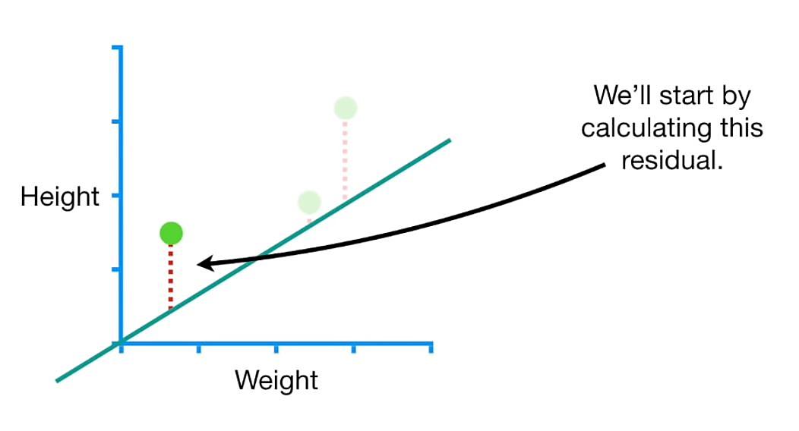

Slide 21
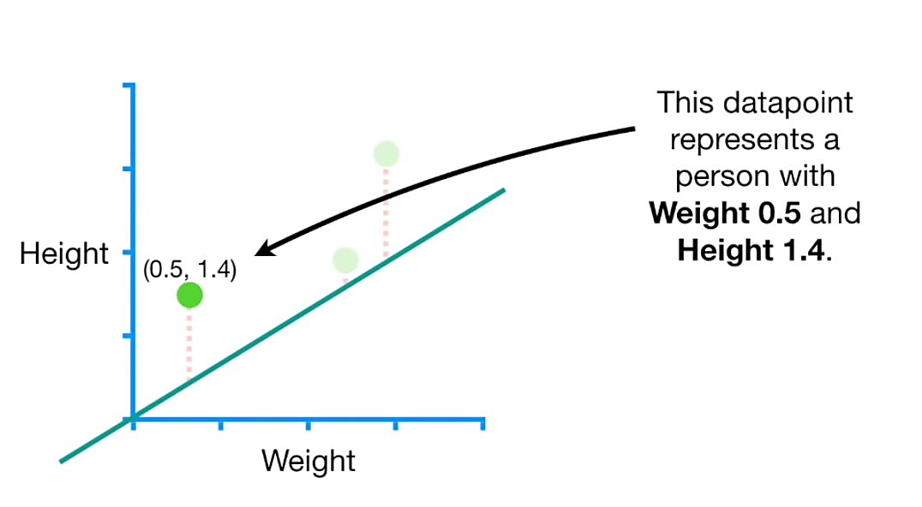

Slide 22
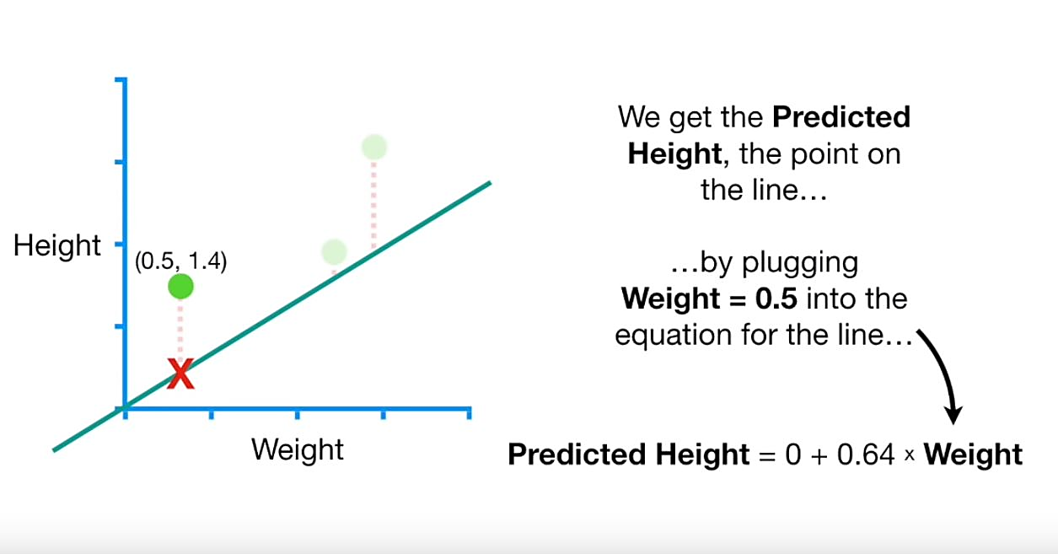

Slide 23
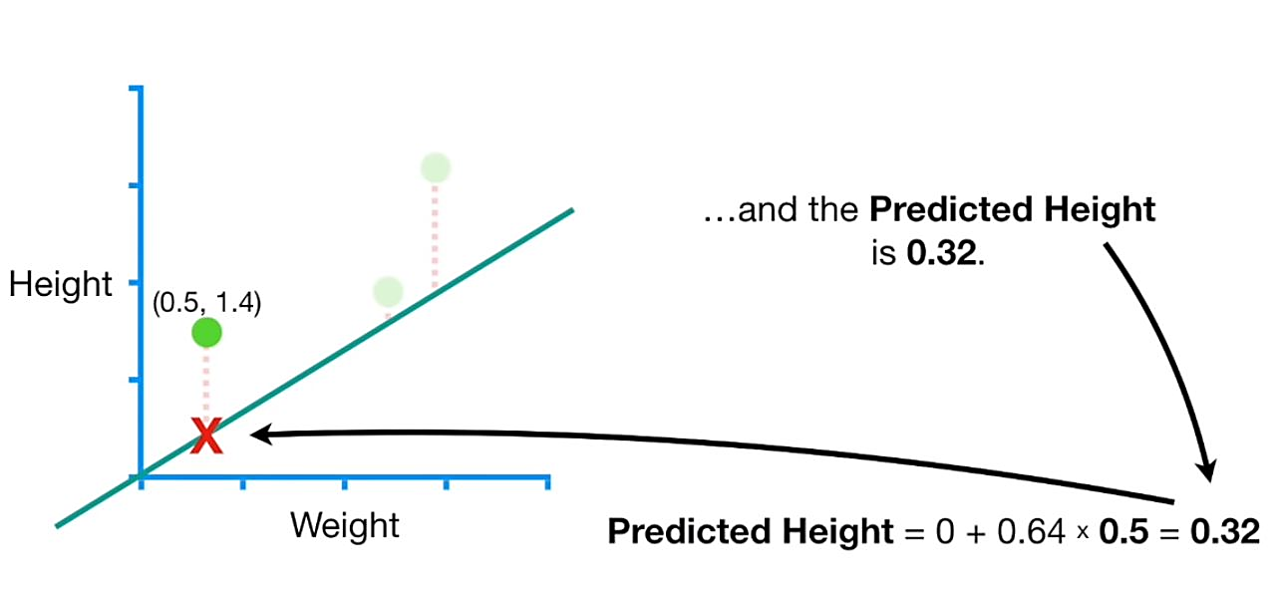

Slide 24
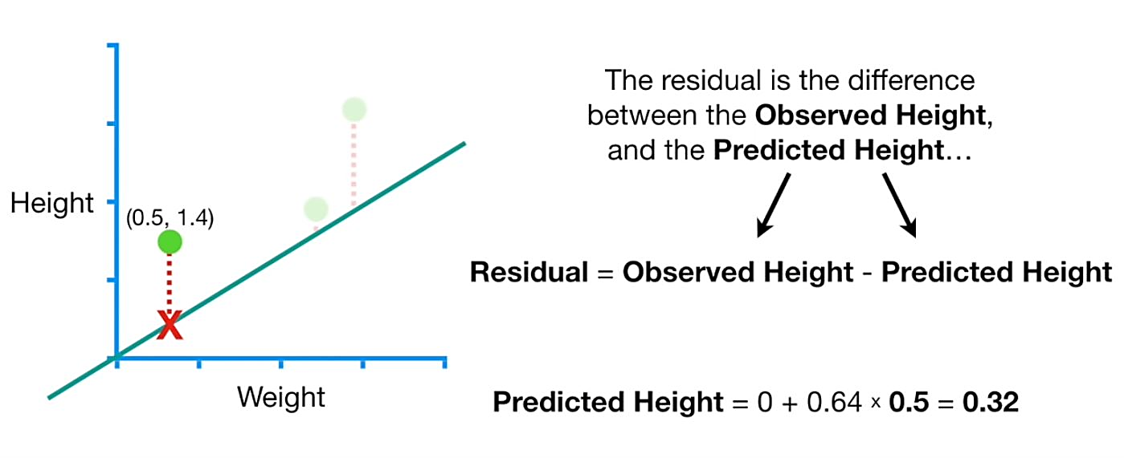

Slide 25
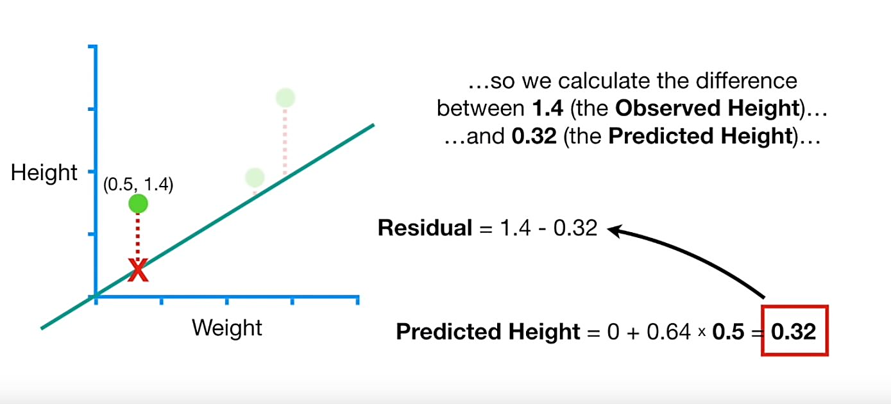

Slide 26
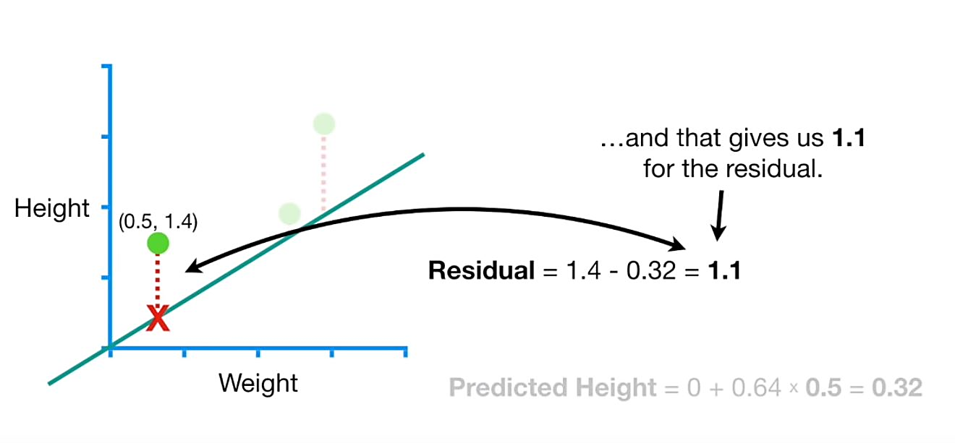

Slide 27
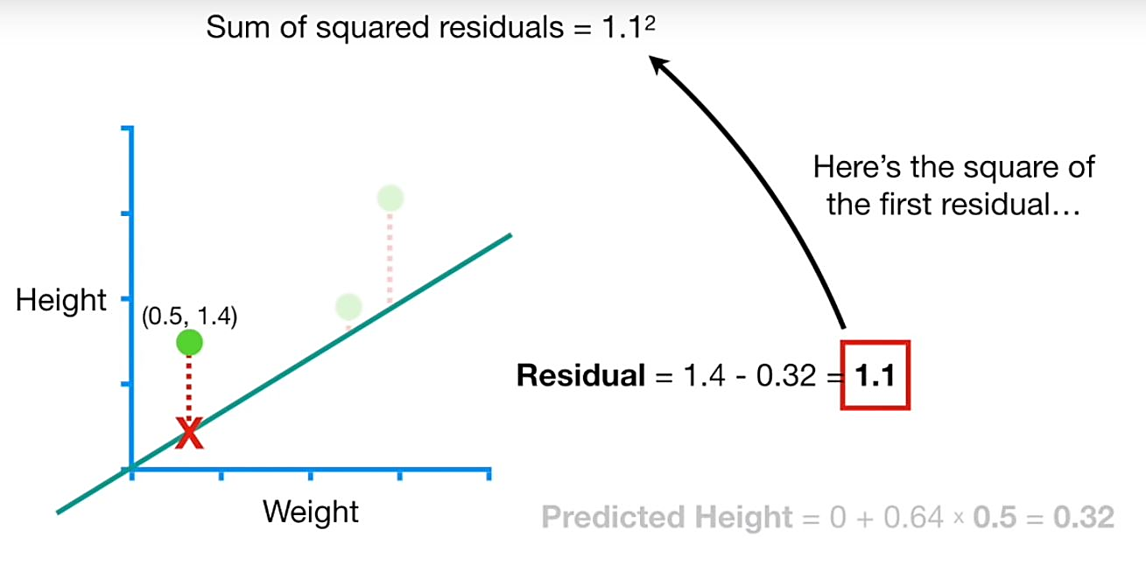
Sum of Squared Residuals = 1.1²

Slide 28
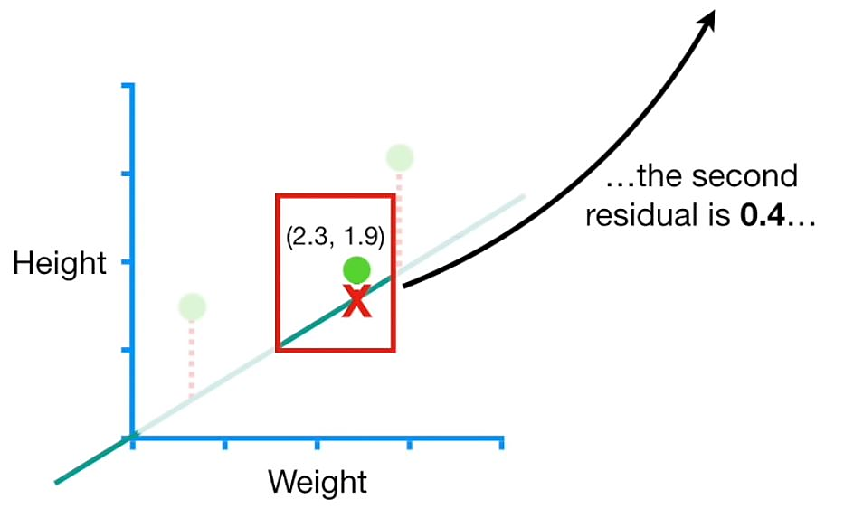
Sum of Squared Residuals = 1.1² + 0.4²

Slide 29
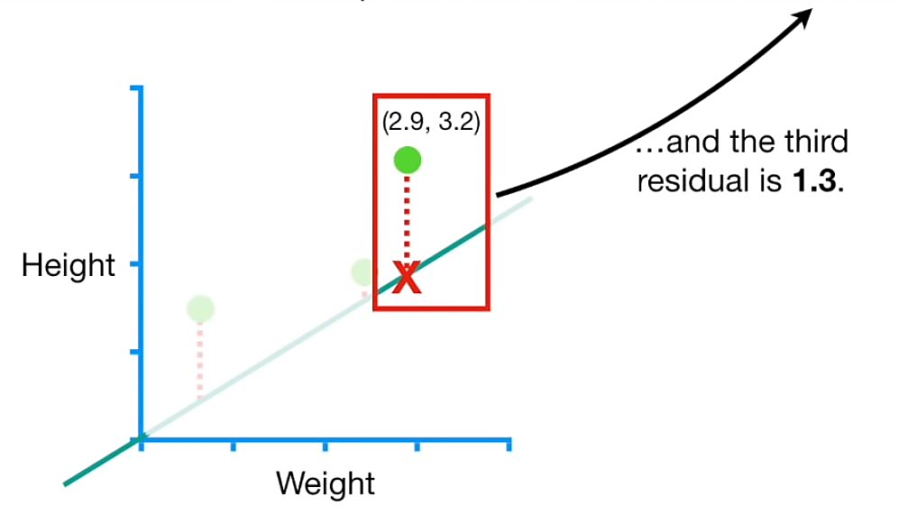
Sum of Squared Residuals = 1.1² + 0.4² + 1.3²

Slide 30
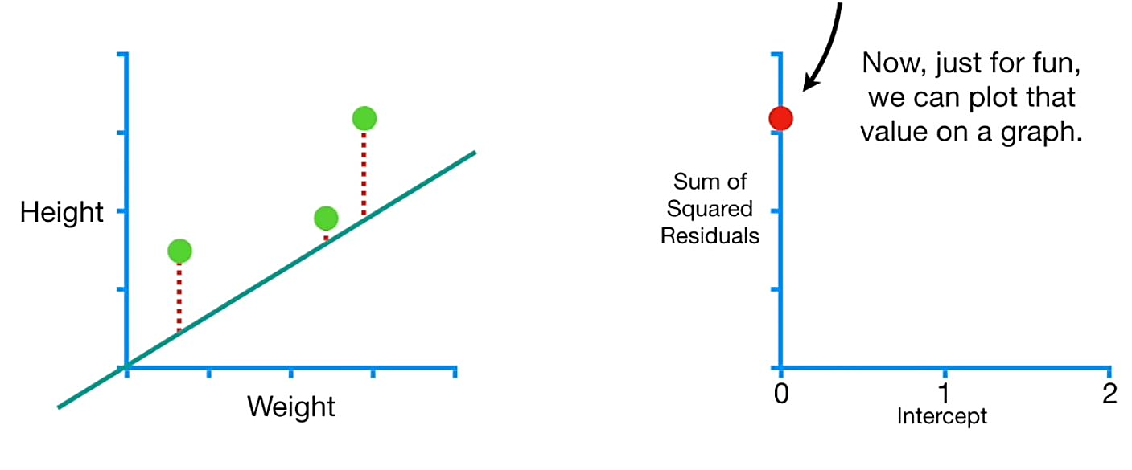
Sum of Squared Residuals = 1.1² + 0.4² + 1.3² = 3.1

Slide 31
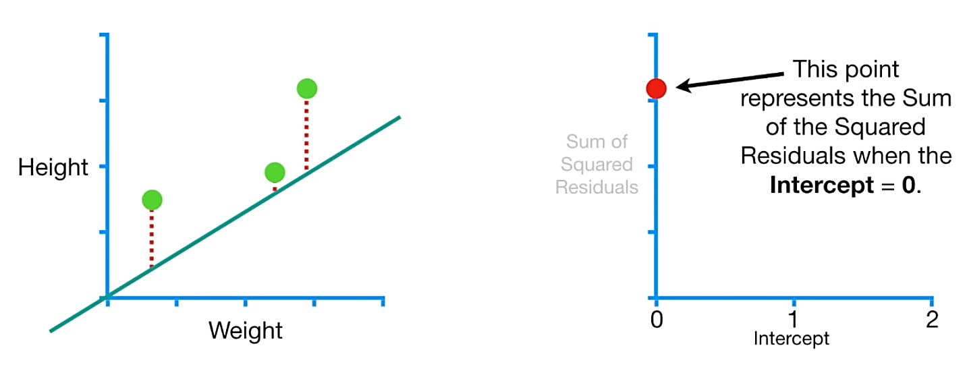

Slide 32
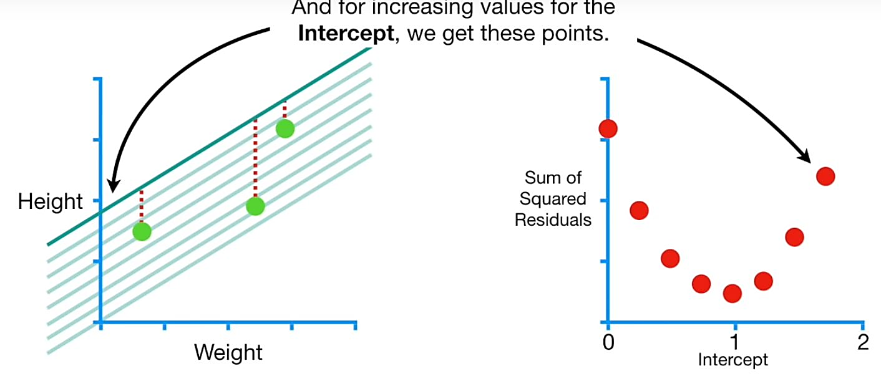
And for increasing values for the

Slide 33
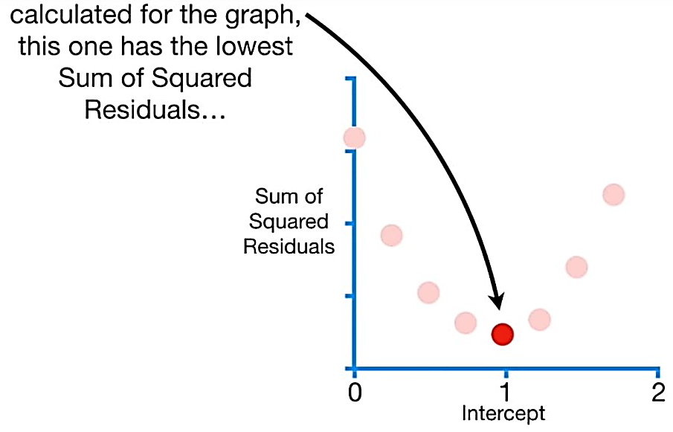
Of the points that we

Slide 34
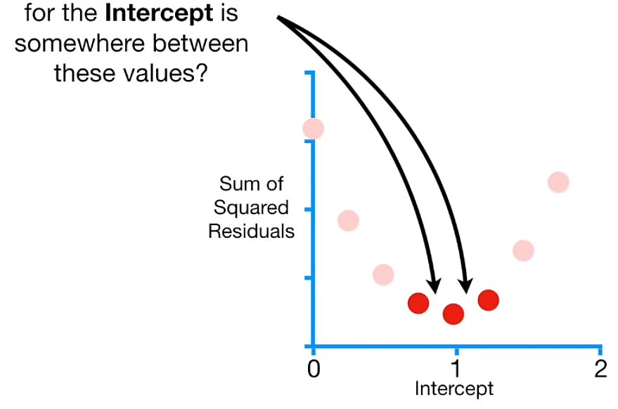
What if the best value

Slide 35
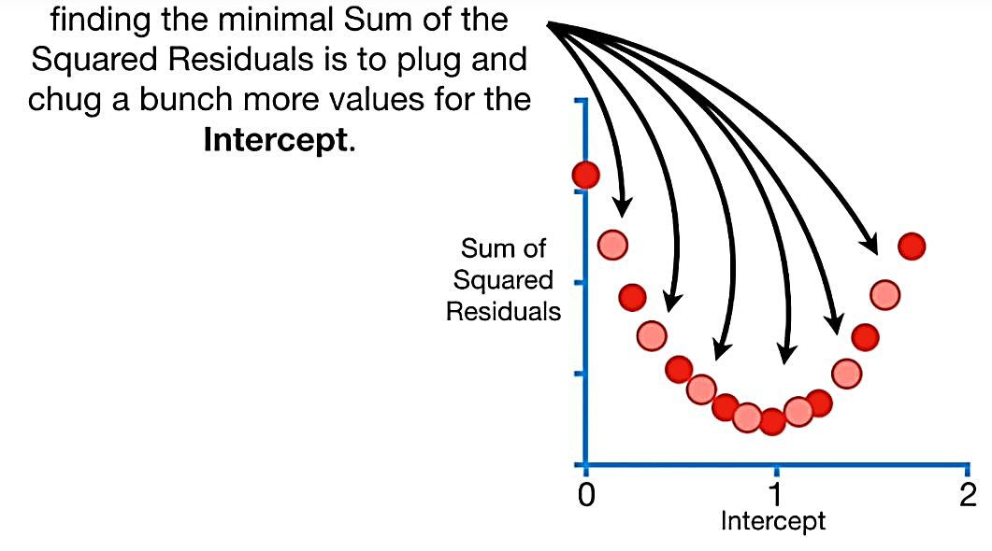
A slow and painful method of

Slide 36
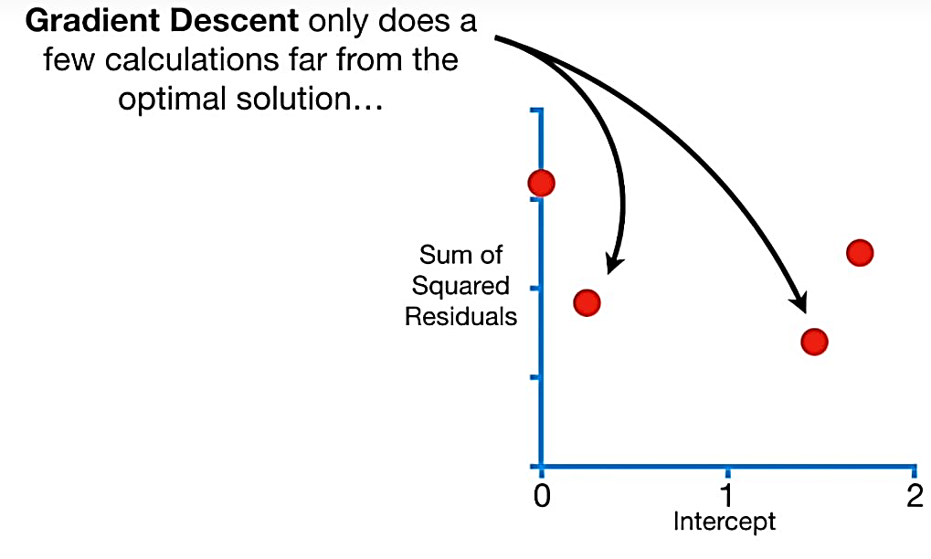

Slide 37
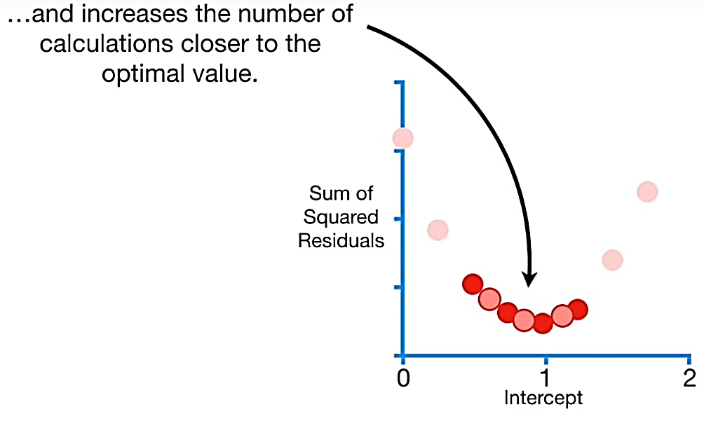

Slide 38
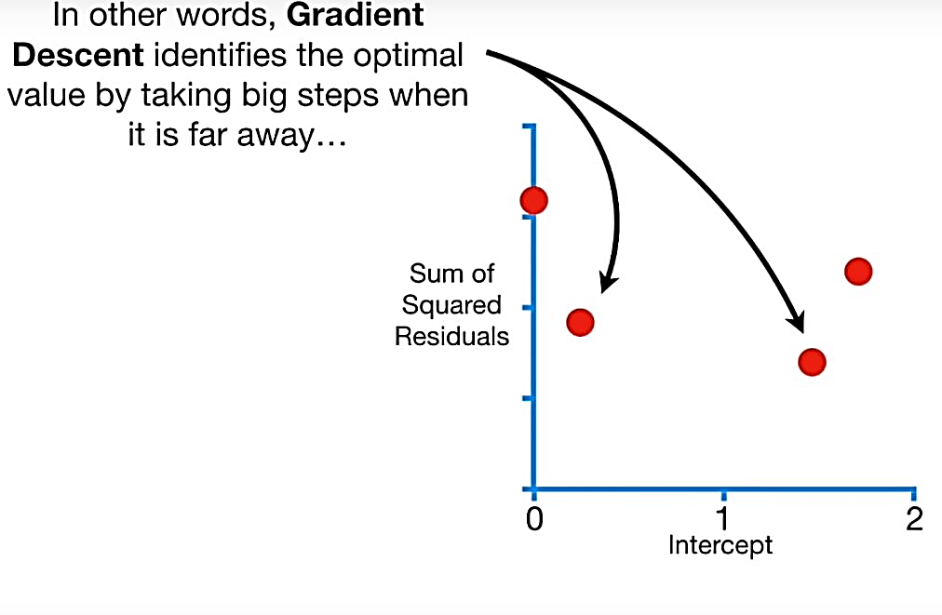
In other words Gradient

Slide 39
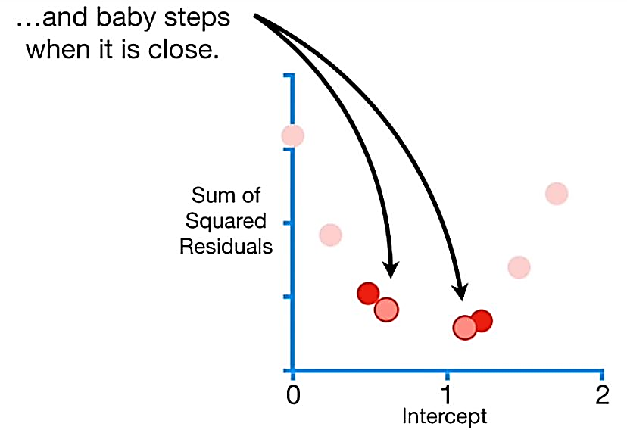

Slide 40
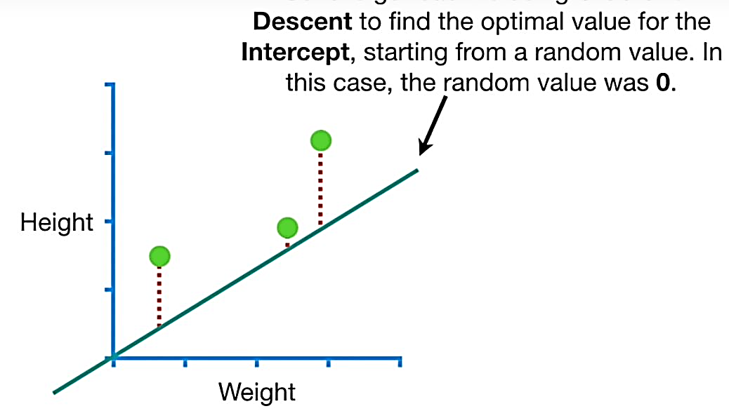
So let us calculate Gradient

Slide 41
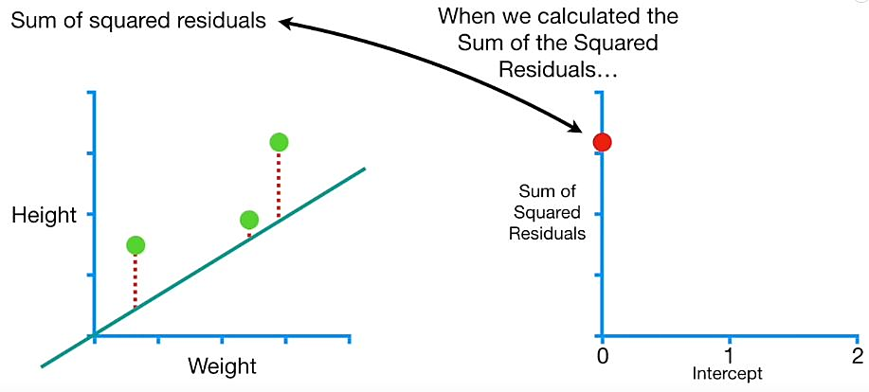

Slide 42
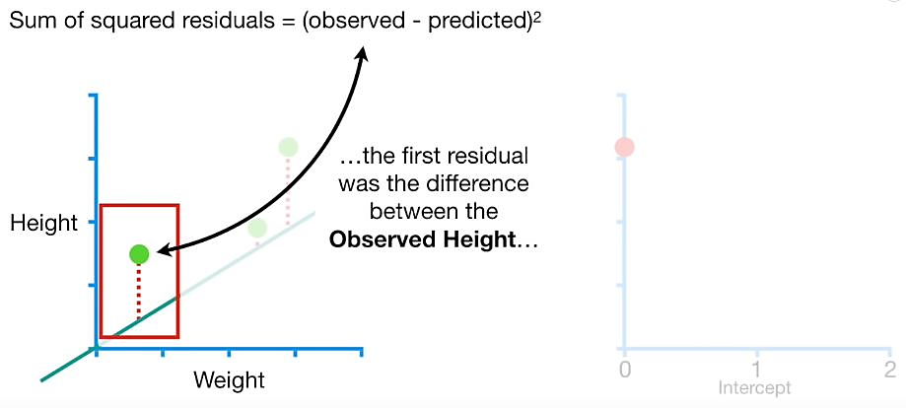

Slide 43
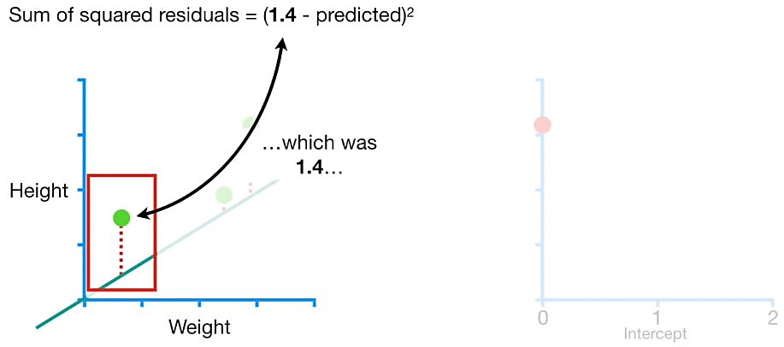

Slide 44
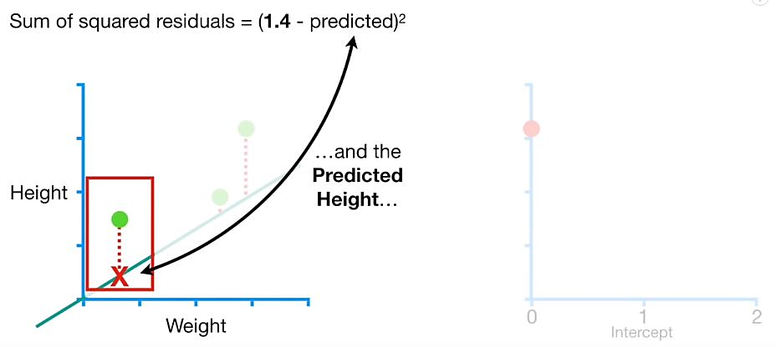

Slide 45
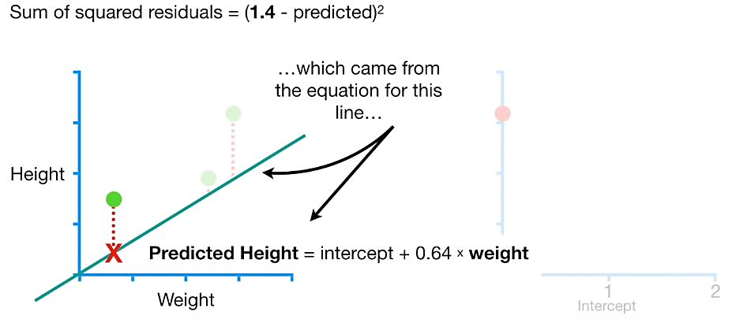

Slide 46
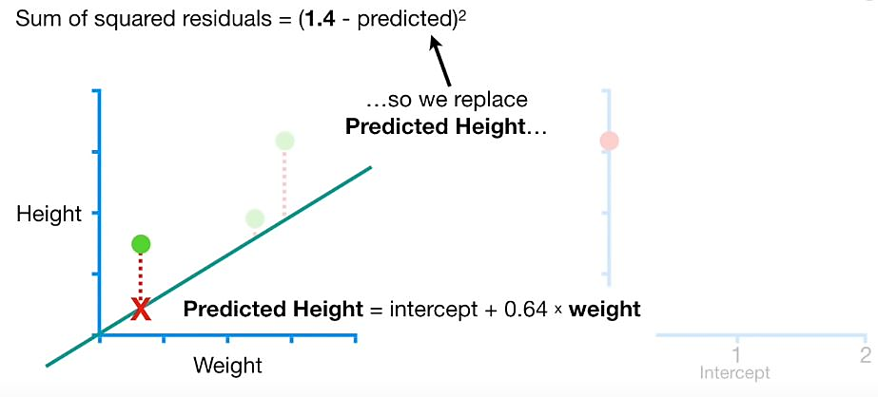

Slide 47
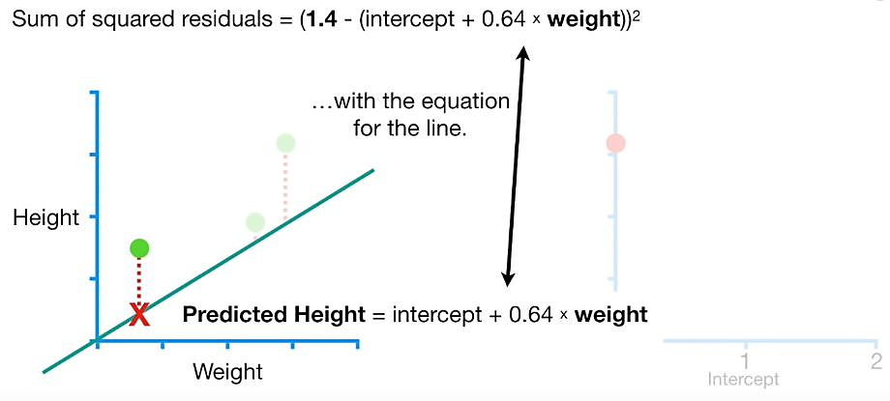

Slide 48
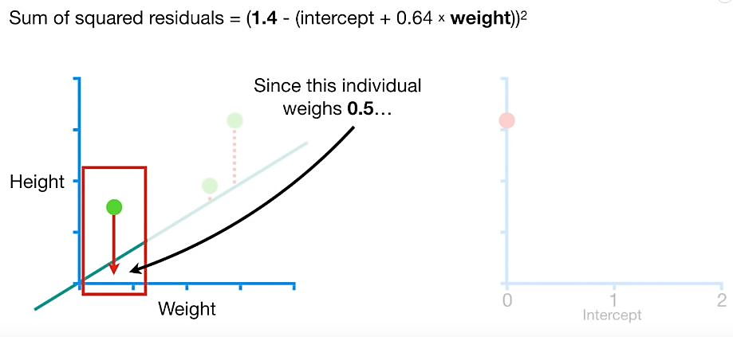

Slide 49
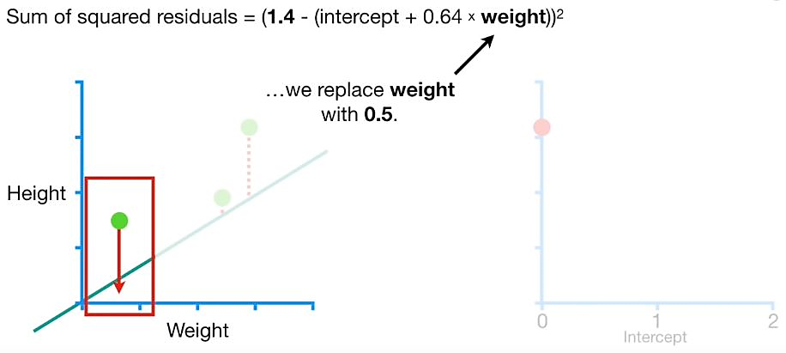

Slide 50
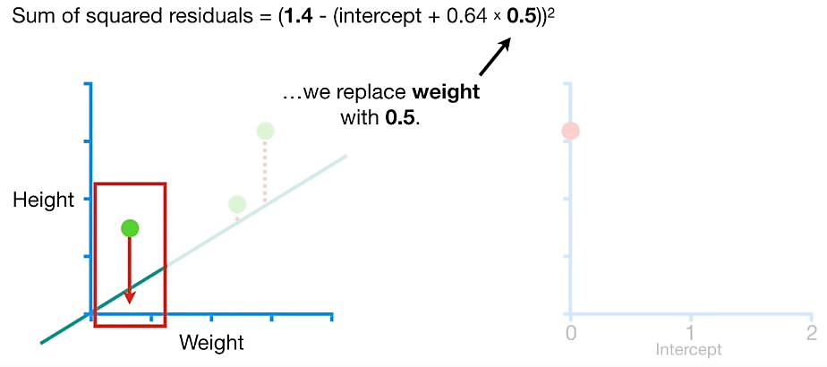

Slide 51


Slide 52


Slide 53


Slide 54


Slide 55


Slide 56


Slide 57


Slide 58


Slide 59


Slide 60


Slide 62


Slide 63


Slide 64


Slide 65


Slide 66


Slide 67


Slide 68


Slide 69


Slide 70


Slide 71


Slide 72


Slide 73


Slide 74


Slide 75


Slide 76


Slide 77


Slide 78


Slide 79


Slide 80


Slide 81


Slide 82


Slide 83


Slide 84


Slide 85


Slide 86


Slide 87


Slide 88


Slide 89


Slide 90


Slide 91


Slide 92


Slide 93


Slide 94


Slide 95


Slide 96


Slide 97


Slide 98


Slide 99


Slide 100


Slide 101


Slide 102


Slide 103


Slide 104


Slide 105


Slide 106


Slide 107


Slide 108


Slide 109


Slide 110


Slide 111


Slide 112


Slide 113


Slide 114


Slide 115


Slide 116


Slide 117


Slide 118


Slide 119


Slide 120


Slide 121


Slide 122


Slide 123


Slide 124


Slide 125


Slide 126


Slide 127


Slide 128


Slide 129


Slide 130


Slide 131


Slide 132


Slide 133


Slide 134


Slide 135


Slide 136


Slide 137


Slide 138


Slide 139


Slide 140


Slide 141


Slide 142


Slide 143


Slide 144


Slide 145


Slide 146


Slide 147


Slide 148


Slide 149


Slide 150


Slide 151


Slide 152


Slide 153


Slide 154


Slide 155


Slide 156


Slide 157


Slide 158


Slide 159


Slide 160


Slide 161


Slide 162


Slide 163


Slide 164


Slide 165


Slide 166


Slide 167


Slide 168


Slide 169
Gradient descent another approach
Consider a Vector of parameters, say, randomly initialized
θ = [w, b]

Slide 170
Vector of parameters, say, randomly initialized
θ = [w, b]
Change in the values of w, b
∆θ = [∆w, ∆b]

Slide 171

Vector of parameters, say, randomly initialized
θ = [w, b]
Change in the values of w, b
∆θ = [∆w, ∆b]

Slide 172

Vector of parameters, say, randomly initialized
θ = [w, b]
Change in the values of w, b
∆θ = [∆w, ∆b]

Slide 173
We moved in the direction of ∆θ

Slide 174
We moved in the direction of ∆θ
Let us be a bit conservative: move only by a small amount η

Slide 175

We moved in the direction of ∆θ
Let us be a bit conservative: move only by a small amount η

Slide 176

We moved in the direction of ∆θ
Let us be a bit conservative: move only by a small amount η
θ_{new} = θ + η · ∆θ

Slide 177
We moved in the direction of ∆θ
Let us be a bit conservative: move only by a small amount η
θ_{new} = θ + η · ∆θ
Question: What is the right ∆θ to use ?

Slide 178
We moved in the direction of ∆θ
Let us be a bit conservative: move only by a small amount η
θ_{new} = θ + η · ∆θ
Question: What is the right ∆θ to use ?
The answer comes from Taylor series

Slide 179
For ease of notation, let ∆θ = u, then from Taylor series, we have,

Slide 180
For ease of notation, let ∆θ = u, then from Taylor series, we have,

Slide 181

For ease of notation, let ∆θ = u, then from Taylor series, we have,

Slide 182

For ease of notation, let ∆θ = u, then from Taylor series, we have,

Slide 183

Okay, so we have,

Slide 184

Okay, so we have,

Slide 185

Okay, so we have,

Slide 186
Okay, so we have,

Slide 187
Gradient descent rule
The direction u that we intend to move in should be at 180° w.r.t. the gradient.
In other words, move in a direction opposite to the gradient

Slide 188
Parameter update equations
w_{t+1} = w_{t} − η∇w_{t}
b_{t+1} = b_{t} − η∇b_{t}
∂L (w, b)
where, ∇w =
∂w at w = w , b = b
∂L (w, b)
∂b
∇b =
at w = w , b = b

Slide 189
Parameter update equations
w_{t+1} = w_{t} − η∇w_{t}
b_{t+1} = b_{t} − η∇b_{t}
∂L (w, b)
where, ∇w =
∂w at w = w , b = b
∂L (w, b)
∂b
∇b =
at w = w , b = b
So we now have a more principled way of moving in the w-b plane than our “guess work” algorithm

Slide 190


Slide 191
To see this algorithm in practice let us first derive ∇w and ∇b for our toy neural network.

Slide 192


Slide 193
Let’s assume there is only 1 point to fit (x, y)

Slide 194

Let’s assume there is only 1 point to fit (x, y)

Slide 195

Let’s assume there is only 1 point to fit (x, y)

Slide 196


Slide 197


Slide 198

So, if there’s only one point (x, y), we have

Slide 199

So, if there’s only one point (x, y), we have

Slide 200


Slide 201


Slide 202


Slide 203


Slide 204


Slide 205


Slide 206


Slide 207


Slide 208
Representation power of a mul- tilayer network of perceptrons
Representation power of a mul- tilayer network of sigmoid neurons
A multilayer network of perceptronswith a single hidden layer can be used to rep- resent any Boolean function precisely (no errors)
A multilayer network of neurons with a single hidden layer can be used to approximate any continuous function to any desired precision
In other words, there is a guarantee that for any function f (x) : R^{n} → R^{m}, we can always find a neural network (with 1 hidden layer containing enough neurons) whose output g(x) satisfies |g(x) − f (x)| < s !!
Proof: We will see an illustrative proof of this... [Cybenko, 1989], [Hornik, 1991]

Slide 209

One of the most striking facts about neural networks is that they can compute any function at all.
That is, suppose someone hands you some complicated, wiggly function, f(x):

Slide 210

No matter what the function, there is guaranteed to be a neural network so that for every possible input, x, the value f(x) (or some close approximation) is output from the network, e.g.:

Slide 211

No matter what the function, there is guaranteed to be a neural network so that for every possible input, x, the value f(x) (or some close approximation) is output from the network, e.g.:
This result holds even if the function has many inputs, f=f(x₁,…,x_{m}), and many outputs.
For instance, here's a network computing a function with m=3 inputs and n=2 outputs:

Slide 212
This result tells us that neural networks have a kind of universality. No matter what function we want to compute, we know that there is a neural network which can do the job.
What's more, this universality theorem holds even if we restrict our networks to have just a single layer intermediate between the input and the output neurons - a so-called single hidden layer. So even very simple network architectures can be extremely powerful.

Slide 213
A precise statement of the universality theorem is that neural networks with a single hidden layer can be used to approximate any continuous function to any desired precision.
In our case we'll actually prove a slightly weaker version of this result, using two hidden layers instead of one. In the problems I'll briefly outline how the explanation can, with a few tweaks, be adapted to give a proof which uses only a single hidden layer.

Slide 214
We are interested in knowing whether a network of neurons can be used to represent an arbitrary function (like the one shown in the figure).

Slide 215

We are interested in knowing whether a network of neurons can be used to represent an arbitrary function (like the one shown in the figure).
We observe that such an arbitrary function can be approximated by several “tower” functions.
41/62

Slide 216

We are interested in knowing whether a network of neurons can be used to represent an arbitrary function (like the one shown in the figure).
We observe that such an arbitrary function can be approximated by several “tower” functions.
More the number of such “tower” functions, better the approximation
41/62

Slide 217

We are interested in knowing whether a network of neurons can be used to represent an arbitrary function (like the one shown in the figure).
We observe that such an arbitrary function can be approximated by several “tower” functions.
More the number of such “tower” functions, better the approximation
To be more precise, we can approximate any arbitrary function by a sum of such “tower functions”.

Slide 218

We make a few observations
All these “tower” functions are similar and only differ in their heights and positions on the x-axis.

Slide 219
We make a few observations
All these “tower” functions are similar and only differ in their heights and positions on the x-axis.
Suppose there is a black box which takes the original input (x) and constructs these tower functions.
Tower Tower .
maker maker
. .
. . .
x
Tower Tower maker maker
42/62

Slide 220




We make a few observations
All these “tower” functions are sim- ilar and only differ in their heights and positions on the x-axis.
Suppose there is a black box which takes the original input (x) and constructs these tower functions.
We can then have a simple network which can just add them up to ap- proximate the function.
+
. . .
. . .
. .
. . .
x
Tower Tower .
maker maker
Tower Tower maker maker

Slide 221
We make a few observations
All these “tower” functions are sim- ilar and only differ in their heights and positions on the x-axis.
Suppose there is a black box which takes the original input (x) and constructs these tower functions.
We can then have a simple network which can just add them up to ap- proximate the function.
Our job now is to figure out what is inside this Blackbox.
+
. . .
. . .
. .
. . .
x
Tower Tower .
maker maker
Tower Tower maker maker

Slide 222

If we take the logistic function and set w to a very high value, we will recover the step function.
Let us see what happens as we change the value of w.
σ(x) = ¹ w = 0 to 36, b = 0
_{1+e}−(wx+b)

Slide 223

If we take the logistic function and set w to a very high value, we will recover the step function.
Let us see what happens as we change the value of w.
Further we can adjust the value of b to control the position on the x-axis at which the function transitions from 0 to 1.
σ(x) = ¹ w = 36, b = 0 to 36
_{1+e}−(wx+b)

Slide 224

Now let us see what we get by taking two such sigmoid functions (with different b's) and subtracting one from the other

Slide 225

Now let us see what we get by taking two such sigmoid functions (with different b's) and subtracting one from the other.
Voila! We have our tower function !!

Slide 226
Can we come up with a neural network to represent this operation of subtracting one sigmoid function from another ?

Slide 227






Slide 228
What if we have more than one input?
Suppose we are trying to take a decision about whether we will find oil at a particular location on the ocean bed(Yes/No).
Further, suppose we base our decision on two factors: Salinity (x₁) and Pressure (x₂).

Slide 229

What if we have more than one input?
Suppose we are trying to take a decision about whether we will find oil at a particular location on the ocean bed(Yes/No).
Further, suppose we base our decision on two factors: Salinity (x₁) and Pressure (x₂).
We are given some data and it seems that y(oil|no-oil) is a complex function of x₁ and x_{2.}

Slide 230
What if we have more than one input?
Suppose we are trying to take a decision about whether we will find oil at a particular location on the ocean bed(Yes/No).
Further, suppose we base our decision on two factors: Salinity (x₁) and Pressure (x₂)
We are given some data and it seems that y(oil|no-oil) is a complex function of x₁ and x_{2.}
We want a neural network to approximate this function.

Slide 231

This is what a 2-dimensional sigmoid looks like.
1
y =
_{1 + e}−(w1x1+w2x2+b)

Slide 232
This is what a 2-d sigmoid curve looks like. We need to figure out how to get a tower in this case.
1
y =
_{1 + e}−(w1x1+w2x2+b)

Slide 233

This is what a 2-d sigmoid curve looks like. We need to figure out how to get a tower in this case. First let us set w₂ to 0 and see if we can get a 2-d step function.
1
y =
_{1 + e}−(w1x1+w2x2+b)

Slide 234

This is what a 2-dimensional sigmoid looks like
We need to figure out how to get a tower in this case
First, let us set w₂ to 0 and see if we can get a two dimensional step func- tion
What would happen if we change b ?
1
y =
_{1 + e}−(w1x1+w2x2+b)

Slide 235

What if we take two such step func- tions (with different b values) and subtract one from the other

Slide 236

What if we take two such step func- tions (with different b values) and subtract one from the other

Slide 237
What if we take two such step func- tions (with different b values) and subtract one from the other
We still don’t get a tower (or we get a tower which is open from two sides)

Slide 238

Now let us set w₁ to 0 and adjust w₂ to get a 2-dimensional step function with a different orientation
1
y =
_{1 + e}−(w1x1+w2x2+b)
w₁ = 0, w₂ = 0 to 23, b = 0

Slide 239

Now let us set w₁ to 0 and adjust w₂ to get a 2-dimensional step function with a different orientation
1
y =
_{1 + e}−(w1x1+w2x2+b)
And now we change b
w₁ = 0, w₂ = 0 to 23, b = 10 to 50

Slide 240

Again, what if we take two such step functions (with different b values) and subtract one from the other

Slide 241

Again, what if we take two such step functions (with different b values) and subtract one from the other
We still don’t get a tower (or we get a tower which is open from two sides)
Notice that this open tower has a dif- ferent orientation from the previous one

Slide 242

Now what will we get by adding two such open towers ?

Slide 243

Now what will we get by adding two such open towers ?
We get a tower standing on an elev- ated base
We can now pass this output through another sigmoid neuron to get the de- sired tower !

Slide 244




Now what will we get by adding two such open towers ?
We get a tower standing on an elev- ated base
We can now pass this output through another sigmoid neuron to get the de- sired tower !
We can now approximate any function by summing up many such towers

Slide 245

For example, we could approximate the following function using a sum of several towers

Slide 246
Can we come up with a neural network to represent this entire procedure of constructing a 3-dimensional tower ?

Slide 247











Slide 248










Slide 249
For 1-dimensional input we needed 2 neurons to construct a tower
For 2-dimensional input we needed 4 neurons to construct a tower
How many neurons will you need to construct a tower in n dimensions ?

Slide 250
Why do we care about approximating any arbitrary function ?
Can we tie all this back to the classification problem that we have been dealing with ? (oil mining)

Slide 251

We are interested in separating the blue points from the red points
Suppose we use a single sigmoidal neuron to approximate the relation between x = [x1, x2] and y

Slide 252

We are interested in separating the blue points from the red points.
Suppose we use a single sigmoidal neuron to approximate the relation between x = [x1, x2] and y.
Obviously, there will be errors (some blue points get classified as 1 and some red points
get classified as 0)

Slide 253
We are interested in separating the blue points from the red points.
Suppose we use a single sigmoidal neuron to approximate the relation between x = [x1, x2] and y.
Obviously, there will be errors (some blue points get classified as 1 and some red points
This is what we actually want.
get classified as 0)

Slide 254
We are interested in separating the blue points from the red points.
Suppose we use a single sigmoidal neuron to approximate the relation between x = [x1, x2] and y.
Obviously, there will be errors (some blue points get classified as 1 and some red points
This is what we actually want.
The illustrative proof that we just saw tells us that we can have a neural network with two hidden layers which can approximate the above function by a sum of towers.
get classified as 0)

Slide 255
We are interested in separating the blue points from the red points.
Suppose we use a single sigmoidal neuron to approximate the relation between x = [x1, x2] and y.
Obviously, there will be errors (some blue points get classified as 1 and some red points
This is what we actually want
The illustrative proof that we just saw tells us that we can have a neural network with two hidden layers which can approximate the above function by a sum of towers
Which means we can have a neural network which can exactly separate the blue points
get classified as 0)
from the red points !!

